Slide 2
What is Big Data?
Big data is a combination of structured, semi- structured and unstructured data collected by organizations that can be mined for information and used in machine learning projects, predictive modeling and other advanced analytics applications.

Slide 3
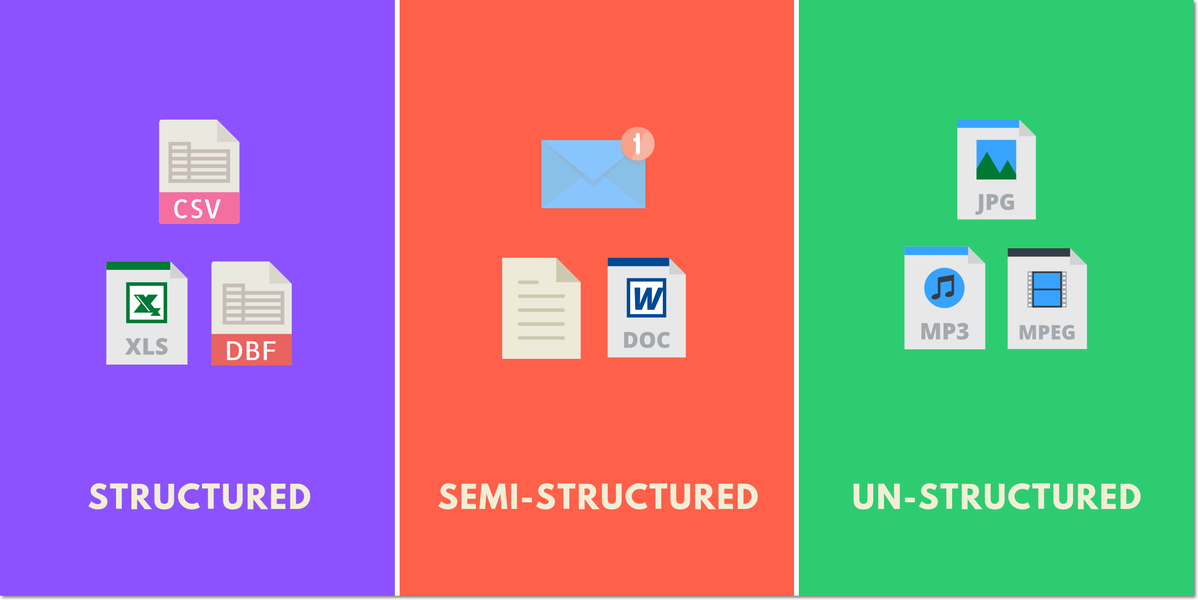
Types of Data

Slide 4

INTRODUCTION TO BIG DATA

Slide 5
INTRODUCTION TO BIG DATA
TEXT

Slide 6

INTRODUCTION TO BIG DATA
TEXT

Slide 7

INTRODUCTION TO BIG DATA
TEXT

Slide 8






INTRODUCTION TO BIG DATA
4 billion snap
99,000 searches every single second
4.75 billion
4.5 million videos
188 million
4 lakh 56000 tweets
https://www.oberlo.in/blog/google-search-statistics

Slide 9
Quick Quiz?
Big data means-
Very large amount of data
The data which has some importance to a business
Both of them
None of them

Slide 10
Big Data Terminologies
Datasets
Collections or groups of related data are generally referred to as datasets. Each group or dataset member (datum) shares the same set of attributes or properties as others in the same dataset.
Data Analysis
Data analysis is the process of examining data to find facts, relationships, patterns, insights and/or trends.
The overall goal of data analysis is to support better decision making.
Ex: “how the number of ice cream cones sold is related to the daily temperature?”

Slide 11
Big data terminologies
Big Data Analytics
The Big Data analytics lifecycle generally involves identifying, procuring, preparing and analyzing large amounts of raw, unstructured data to extract meaningful information

Slide 12
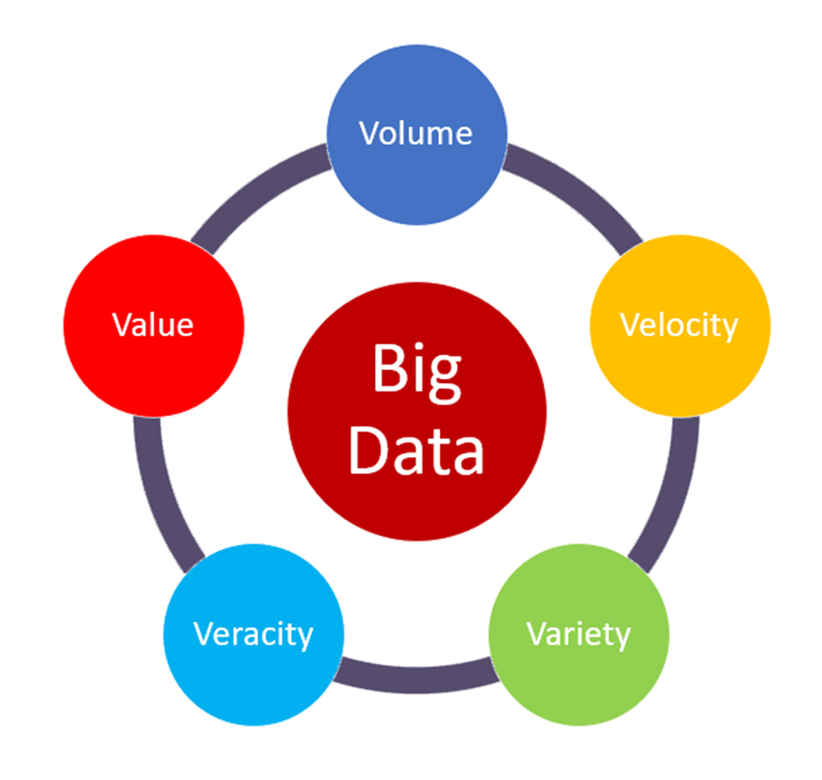
INTRODUCTION TO BIG DATA
5v’s

Slide 13
5v’s

Slide 14
5v’s

Slide 15
5v’s

Slide 16
Types of Data Analytics
Data analytics can be broken into four key types:
Descriptive, which answers the question, “What happened?”
Diagnostic, which answers the question, “Why did this happen?”
Predictive, which answers the question, “What might happen in the future?”
Prescriptive, which answers the question, “What should we do next?”

Slide 17
Descriptive Analytics
Descriptive analytics are carried out to answer questions about events that have already occurred. This form of analytics contextualizes data to generate information.
Sample questions can include:
• What was the sales volume over the past 12 months?
• What is the number of support calls received as categorized by severity and geographic location?
• What is the monthly commission earned by each sales agent?
It is estimated that 80% of generated analytics results are descriptive in nature.
Value wise, descriptive analytics provide the least worth and require a relatively basic skill set.

Slide 18
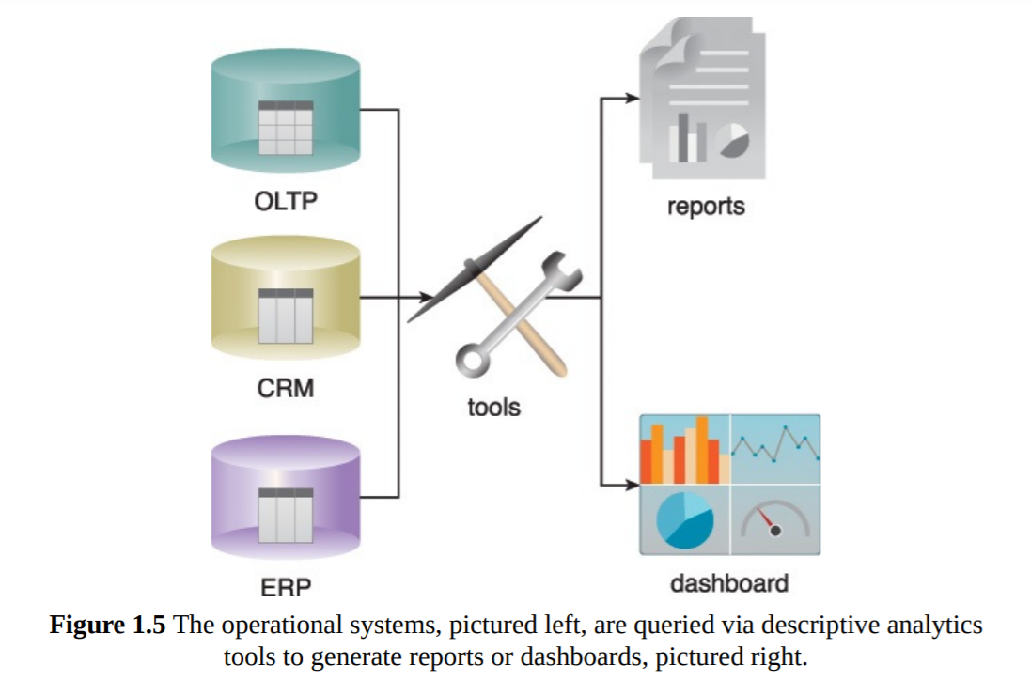
Descriptive analytics are often carried out via ad-hoc reporting or dashboards

Slide 19
Diagnostic Analytics
Diagnostic Analytics Diagnostic analytics aim to determine the cause of a phenomenon that occurred in the past using questions that focus on the reason behind the event.
Such questions include:
• Why were Q2 sales less than Q1 sales?
• Why have there been more support calls originating from the Eastern region than from the Western region?
• Why was there an increase in patient re-admission rates over the past three months? ind the event.
Diagnostic analytics results are viewed via interactive visualization tools that enable users to identify trends and patterns.

Slide 20
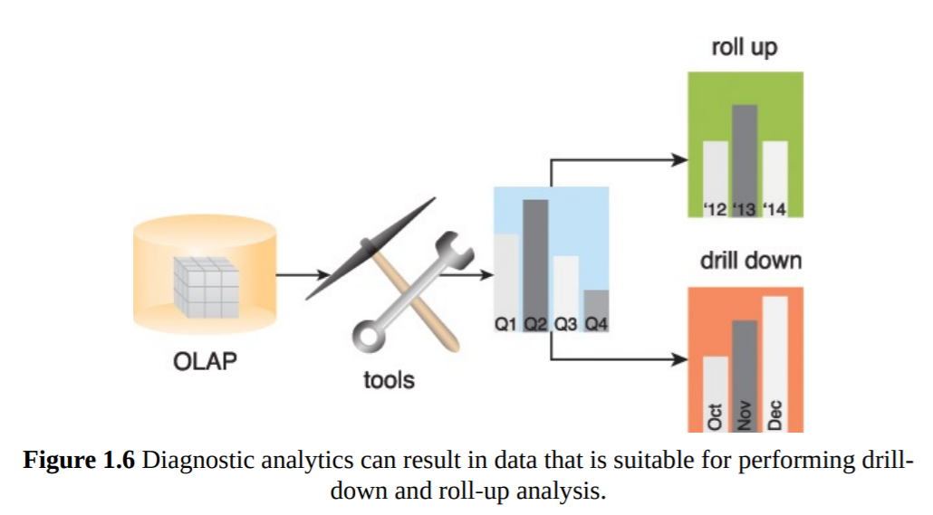
Diagnostic analytics usually require collecting data from multiple sources and storing it in a structure that lends itself to performing drill-down and roll-up analysis

Slide 21
Predictive analytics
Predictive analytics are carried out in an attempt to determine the outcome of an event that might occur in the future.
Questions are usually formulated using a what-if rationale, such as the following:
• What are the chances that a customer will default on a loan if they have missed a monthly payment?
• What will be the patient survival rate if Drug B is administered instead of Drug A?
• If a customer has purchased Products A and B, what are the chances that they will also purchase Product C?
Predictive analytics try to predict the outcomes of events, and predictions are made based on patterns, trends and exceptions found in historical and current data.

Slide 22
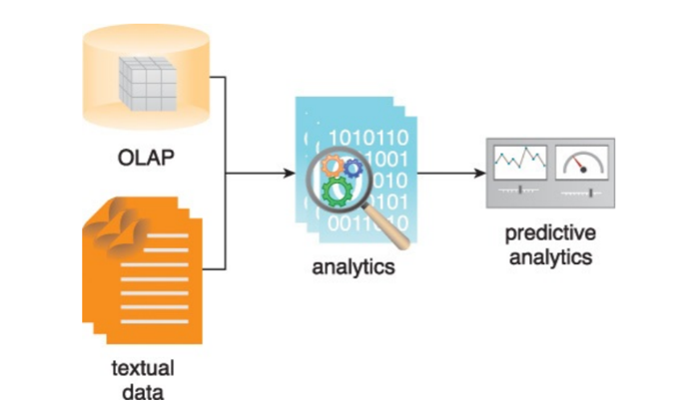

Slide 23
Prescriptive analytics
Prescriptive analytics build upon the results of predictive analytics by prescribing actions that should be taken.
Sample questions may include:
• Among three drugs, which one provides the best results?
• When is the best time to trade a particular stock?

Slide 24
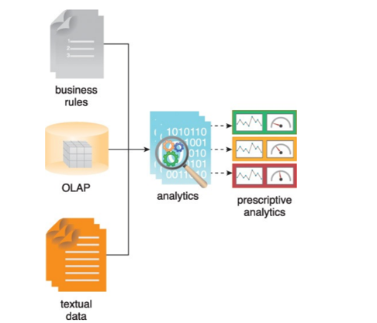
Prescriptive analytics involve the use of business rules and large amounts of internal and external data to simulate outcomes and prescribe the best course of action

Slide 25
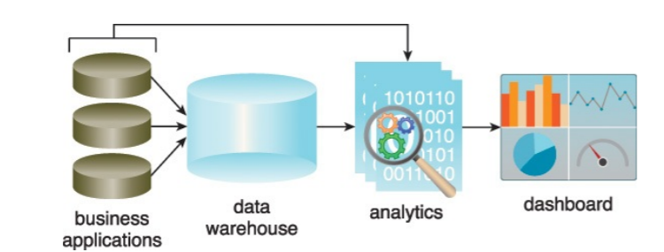
Business Intelligence (BI)
BI enables an organization to gain insight into the performance of an enterprise by analyzing data generated by its business processes and information systems.
BI applies analytics to large amounts of data across the enterprise, which has typically been consolidated into an enterprise data warehouse to run analytical queries.

Slide 26
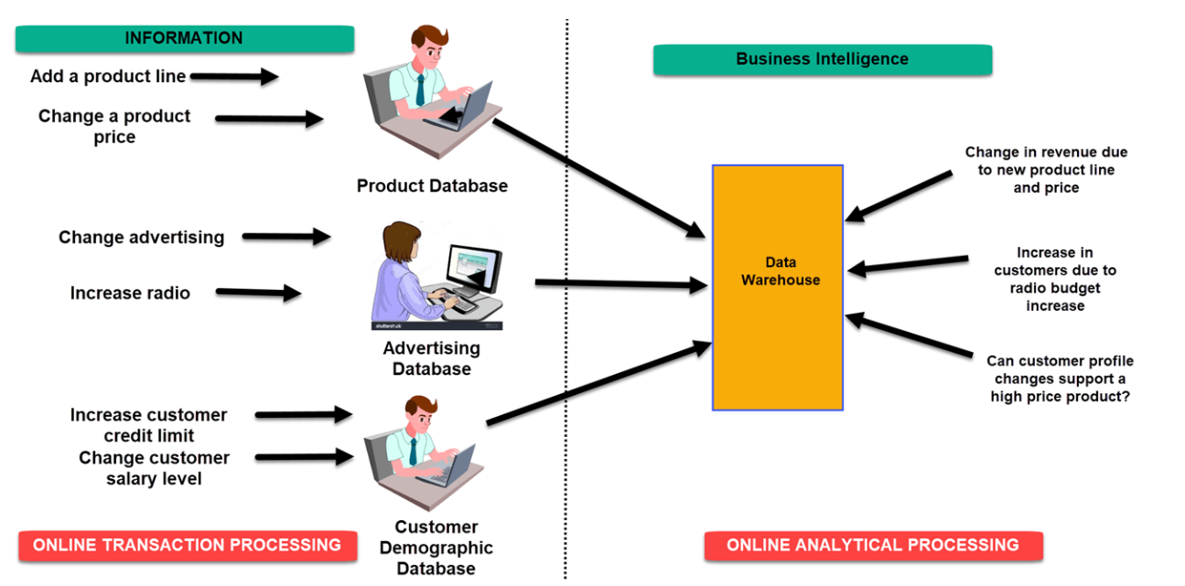
BI

Slide 27
Why Are KPIs Important?
KPIs are an important way to ensure your teams are supporting the overall goals of the organization. Here are some of the biggest reasons why you need key performance indicators.
Keep your teams aligned: Whether measuring project success or employee performance, KPIs keep teams moving in the same direction.
Provide a health check: Key performance indicators give you a realistic look at the health of your organization, from risk factors to financial indicators.
Make adjustments: KPIs help you clearly see your successes and failures so you can do more of what’s working, and less of what’s not.
Hold your teams accountable: Make sure everyone provides value with key performance indicators that help employees track their progress and help managers move things along.

Slide 28
Structural variation of Data in action
In real time scenario, the data we found can be broadly categorize in the basis of its form:
Structured data: conforms to a data model or schema and is often stored in tabular form.
Ex: SQL Table in DBMS
Unstructured Data : Data that does not conform to a data model or data schema is known as unstructured data
Ex: Image, Video, Audio etc.
Semi-structured Data: Semi-structured data has a defined level of structure and consistency, but is not relational in nature
Ex: XML, JSON files, Sensor Data etc.

Slide 29
CASE STUDY
Case Study Example
Although ETI has chosen Big Data for the implementation of its strategic goals, as it currently stands, ETI has no in-house Big Data skills and needs to choose between hiring a Big Data consultant or sending its IT team on a Big Data training course.
The latter option is chosen. However, only the senior IT team members are sent to the training in anticipation of a cost-effective, long-term solution where the trained team members will become a permanent in-house Big Data resource that can be consulted any time and can also train junior team members to further increase the in-house Big Data skillset.

Slide 30
Having received the Big Data training, the trained team members emphasize the need for a common vocabulary of terms so that the entire team is on the same page when talking about Big Data. An example-driven approach is adopted.
When discussing datasets, some of the related datasets pointed out by the team members include claims, policies, quotes, customer profile data and census data. Although the data analysis and data analytics concepts are quickly comprehended, some of the team members that do not have much business exposure have trouble understanding BI and the establishment of appropriate KPIs.
One of the trained IT team members explains BI by using the monthly report generation process for evaluating the previous month’s performance as an example. This process involves importing data from operational systems into the EDW and generating KPIs such as policies sold and claims submitted, processed, accepted and rejected that are displayed on different dashboards and scorecards.

Slide 31
In terms of analytics, ETI makes use of both descriptive and diagnostic analytics.
Descriptive analytics include querying the policy administration system to determine the number of polices sold each day, querying the claims management system to find out how many claims are submitted daily and querying the billing system to find out how many customers are behind on their premium payments.
Diagnostic analytics are carried out as part of various BI activities, such as performing queries to answer questions such as why last month’s sales target was not met.
This includes performing drill-down operations to breakdown sales by type and location so that it can be determined which locations underperformed for specific types of policies.

Slide 32
ETI currently does not utilize predictive nor prescriptive analytics. However, the adoption of Big Data will enable it to perform these types of analytics as now it can make use of unstructured data, which when combined with structured data provides a rich resource in support of these analytics types.
ETI has decided to implement these two types of analytics in a gradual manner by first implementing predictive analytics and then slowly building up their capabilities to implement prescriptive analytics.

Slide 33
At this stage, ETI is planning to make use of predictive analytics in support of achieving its goals.
For example, predictive analytics will enable detection of fraudulent claims by predicting which claim is a fraudulent one and in case of customer defection by predicting which customers are likely to defect. In the future, via prescriptive analytics, it is anticipated that ETI can further enhance the realization of its goals.
For example, prescriptive analytics can prescribe the correct premium amount considering all risk factors or can prescribe the best course of action to take for mitigating claims when faced with catastrophes, such as floods or storms.

Slide 34
Identifying Data Characteristics
The IT team members want to gauge different datasets that are generated inside
ETI’s boundary as well as any other data generated outside ETI’s boundary that may be of interest to the company in the context of volume, velocity, variety, veracity and value characteristics.
The team members take each characteristic in turn and discuss how different datasets manifest that characteristic.

Slide 35
Volume
The team notes that within the company, a large amount of transactional data is generated as a result of processing claims, selling new policies and changes to existing policies.
However, a quick discussion reveals that large volumes of unstructured data, both inside and outside the company, may prove helpful in achieving ETI’s goals.
This data includes health records, documents submitted by the customers at the time of submitting an insurance application, property schedules, fleet data, social media data and weather data.

Slide 36
Velocity
With regards to the in-flow of data, some of the data is low velocity, such as the claims submission data and the new policies issued data. However, data such as webserver logs and insurance quotes is high velocity data.
Looking outside the company, the IT team members anticipate that social media data and the weather data may arrive at a fast pace. Further, it is anticipated that for catastrophe management and fraudulent claim detection, data needs to be processed reasonably quickly to minimize losses

Slide 37
Variety In pursuit of its goals, ETI will be required to incorporate a range of datasets that include health records, policy data, claim data, quote data, social media data, call center agent notes, claim adjuster notes, incident photographs, weather reports, census data, webserver logs and emails.

Slide 38
Veracity
A sample of data taken from the operational systems and the EDW shows signs of high veracity. The IT team attributes this to the data validation performed at multiple stages including validation at the time of data entry, validation at various points when an application is processing data, such as function-level input validation, and validation performed by the database when data is persisted.
Looking outside ETI’s boundary, a study of a few samples taken from the social media data and weather data demonstrates further decline in veracity indicating that such data will require an increased level of data validation and cleansing to make it high veracity data.
Value
As far as the value characteristic is concerned, all IT team members concur that they need to draw maximum value out of the available datasets by ensuring the datasets are stored in their original form and that they are subjected to the right type of analytics.

